Slide 1
Fast retransmission and recovery

Slide 2
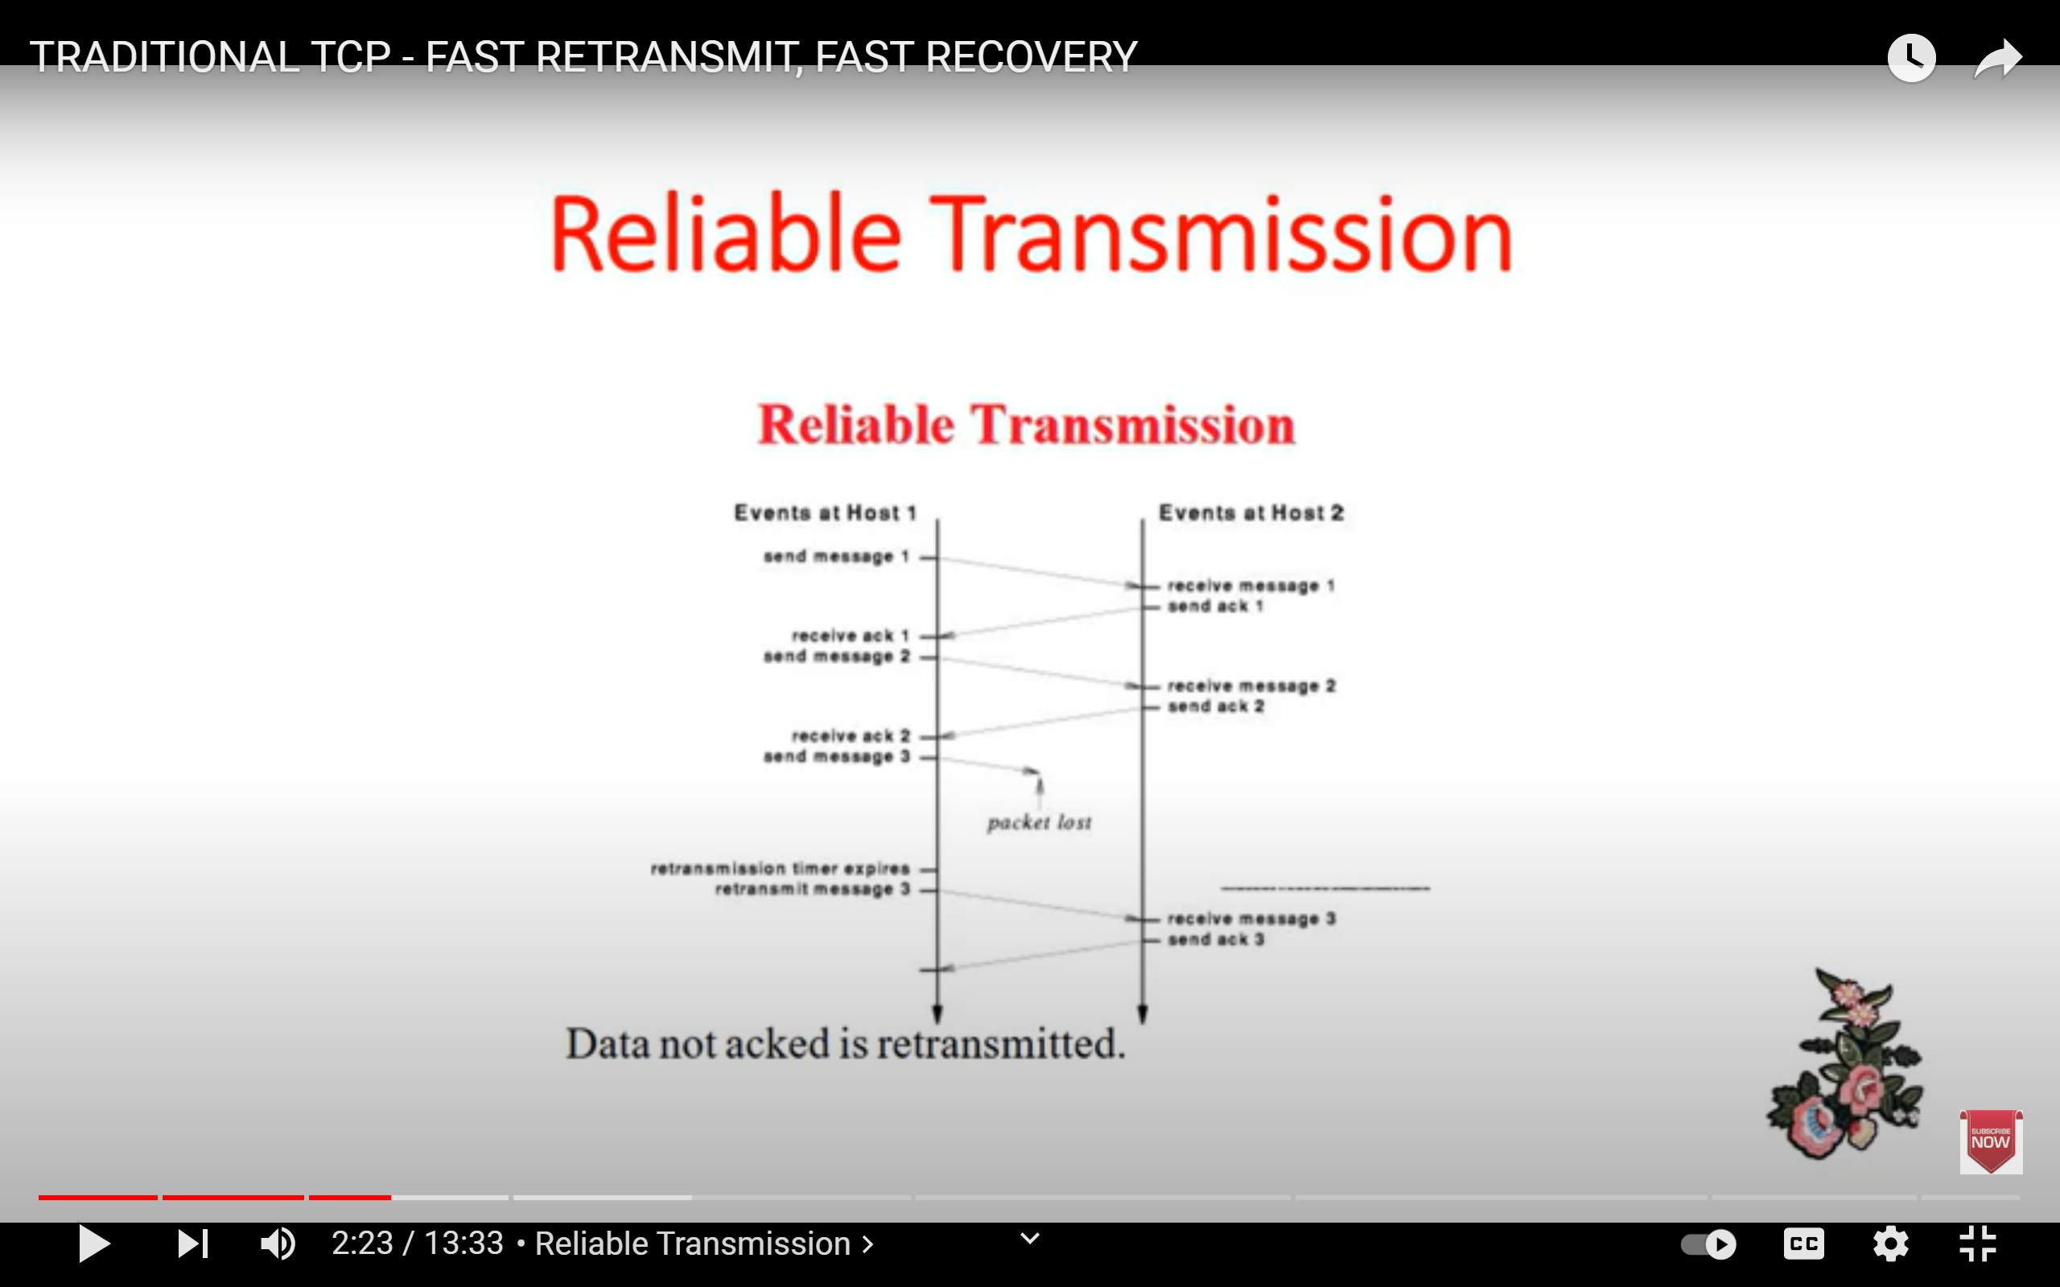
Traditional TCP Reliable Transmission
TCP retransmit after timeout, but timeout can be quite long.
Is there any way for faster retransmit?
Yes, with triple duplicate ACKs

Slide 3
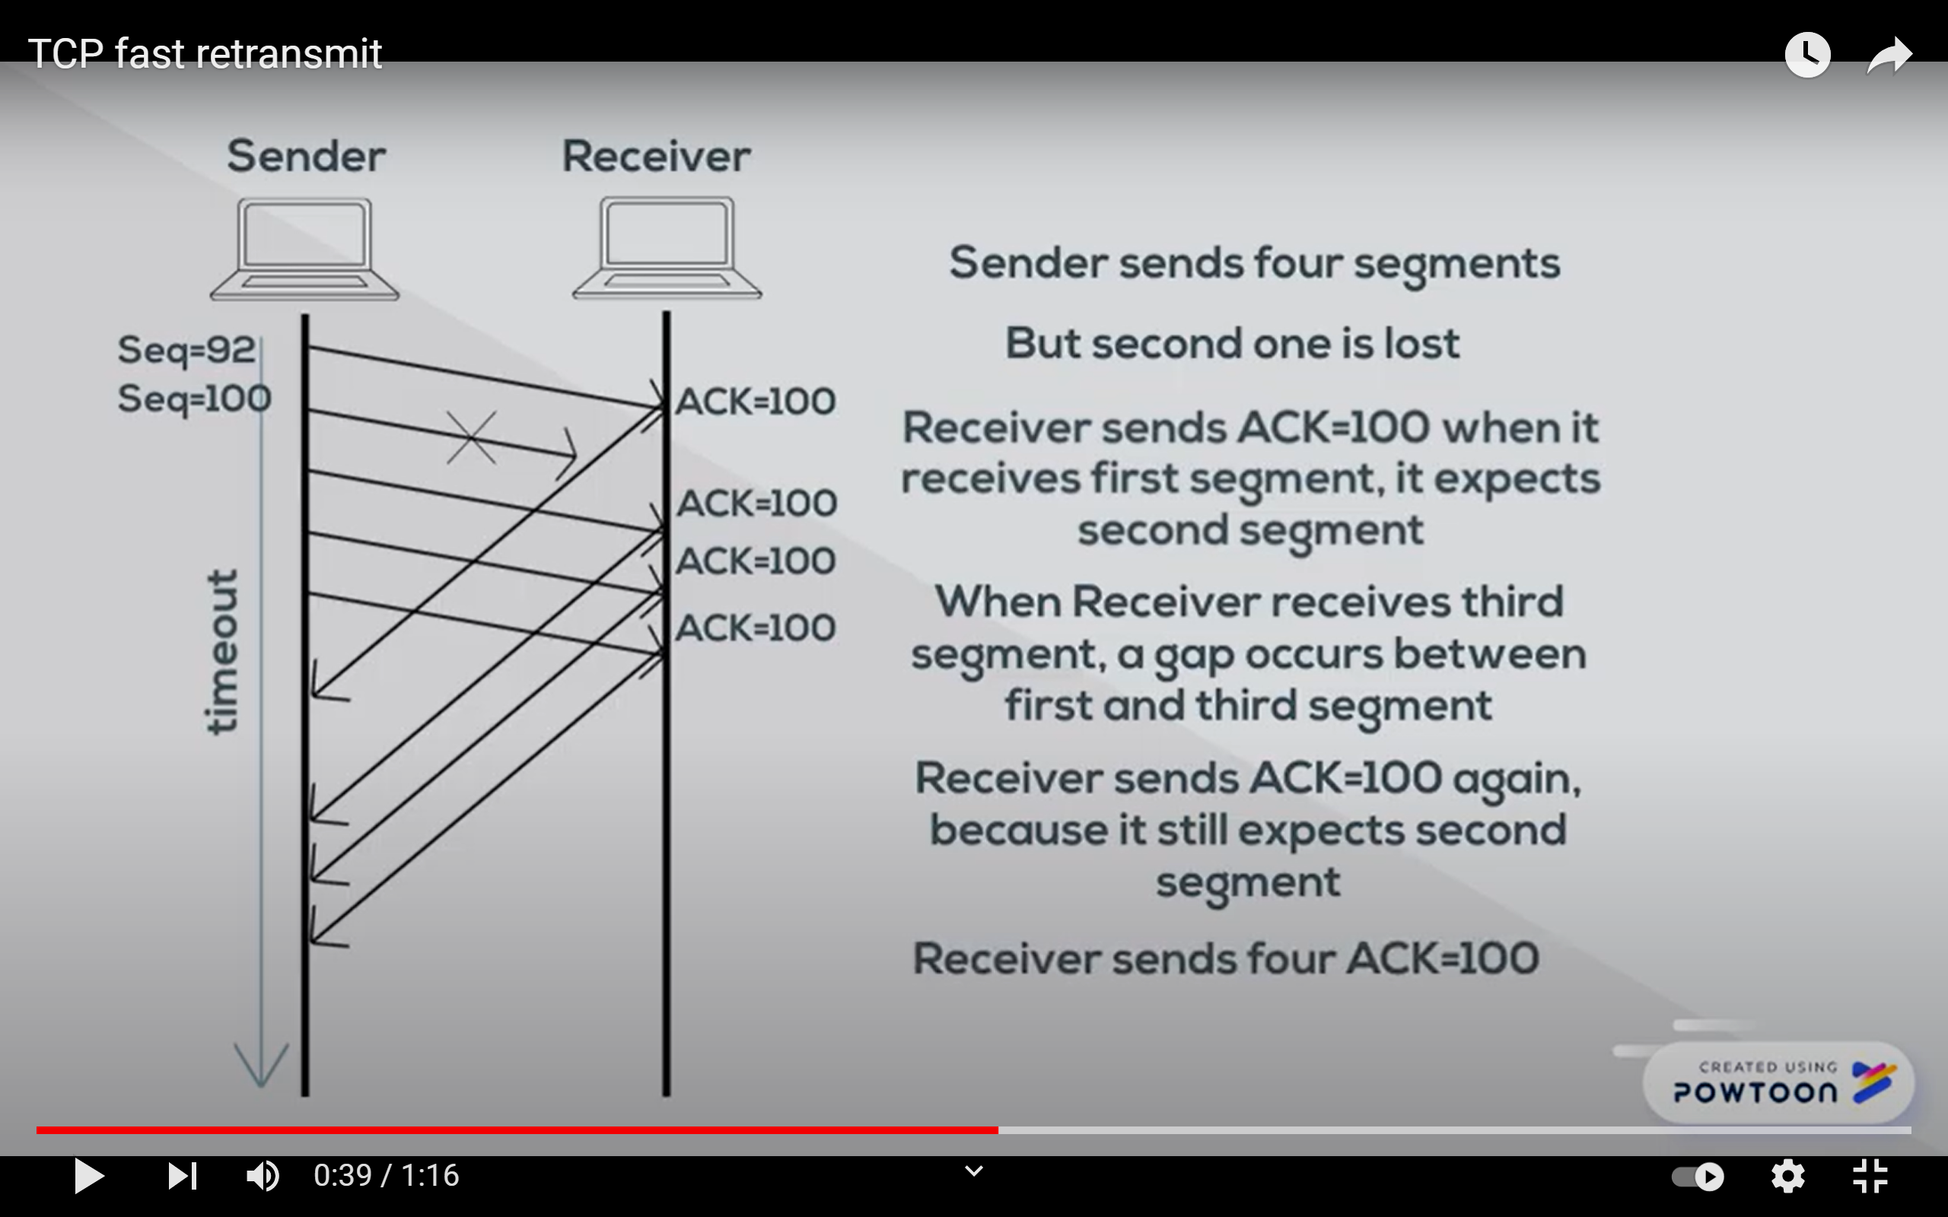
TCP Fast Retransmit
Sender sends four segments
But second is lost
Receiver sends ACK=100 when it receives first segment, it expects second segment.
When Receiver receives third segment, a gap occurs between first and third segment.
Receiver sends ACK=100 again, because it still expects second segment.
Now, Receiver sends four ACK =100.

Slide 4
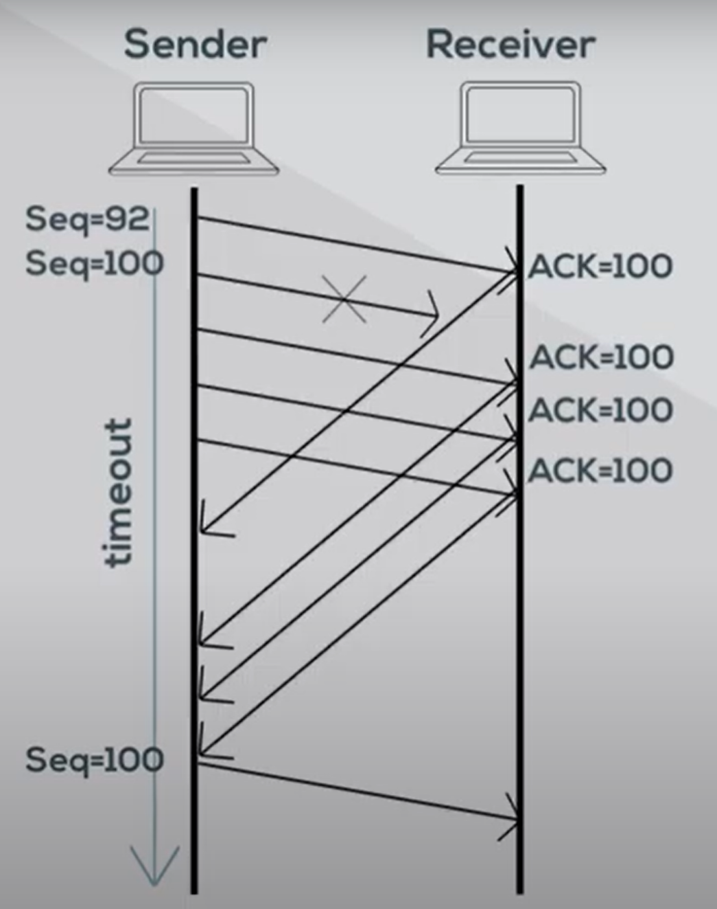
Cont…
When Sender receives triple duplicate ACKs, it sends expected segment immediately.
Even if the timer didn’t timed out yet

Slide 5
Why does TCP wait for three duplicate ACK before fast retransmit?

Slide 6
Cont…
When three duplicate ACKs are detected, TCP performs a fast retransmit and enters the fast recovery state.
Though Fast recovery is not required ,it is recommended.
Without going to the slow start mode(after receiving 3 duplicate ACKs),TCP can enter fast recovery mode, for better performance.
In slow start mode , The congestion window automatically set to 1 MSS(Maximum segment size) and grows exponentially.
But in Fast recovery mode, the congestion window reduced by half and grows linearly, Hence performs better than slow start.

